Slide 1
Data Visualisation-Empowering Business with Effective Insights
THIRUMURUGAN T

Slide 2
Online Retail Dataset
No of Countries
37
Total Unit sold
5M
Total Revenue
8.89M

Slide 3
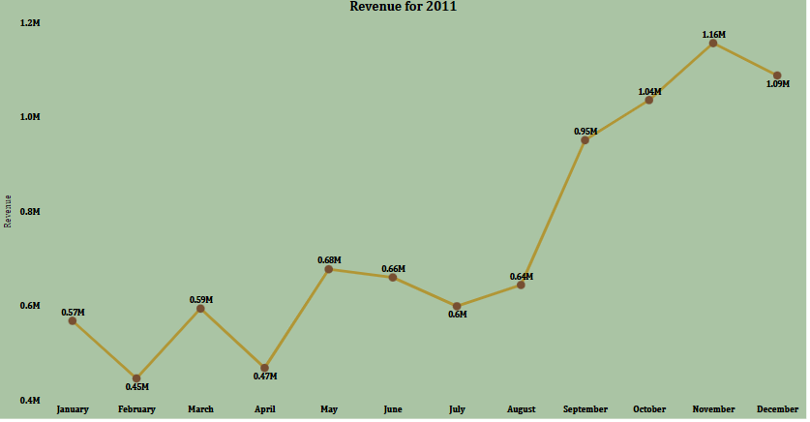
Revenue for Year 2011

Slide 4
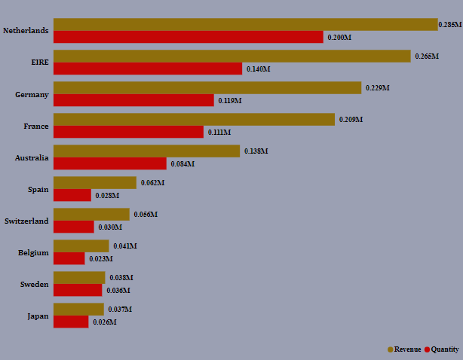
Top 10 Countries Revenue along with Quantity except UK

Slide 5
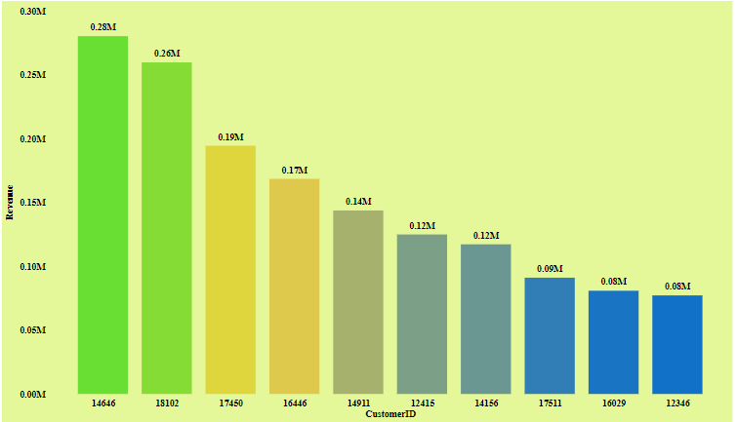
Top 10 Customers by Revenue

Slide 6
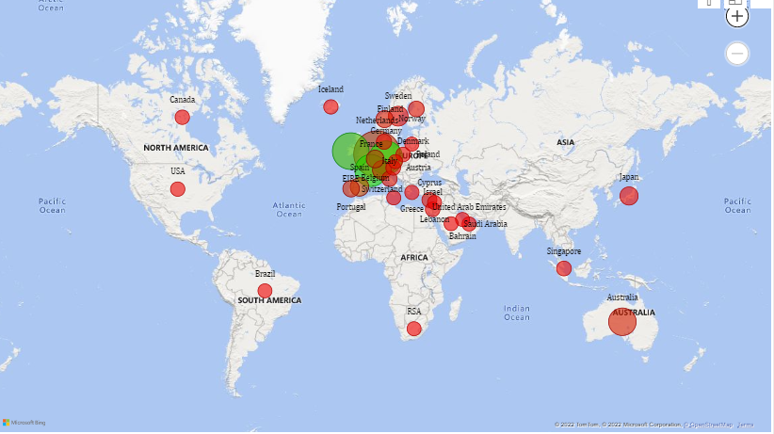
Demand in All Countries

Slide 7
THANK YOU

